Slide 1
Client Side Scripting INTRODUCTION
What is JavaScript and what we can do with it

Slide 2
What is JavaScript
It has nothing to do with Java
Java and JavaScript has similar names for marketing reasons
Developed by Netscape in 1995 to create products and applications that run in a browser
It is primary client side
While originally designed as scripting language, it is actually fully featured language

Slide 3
What can we do with JavaScript
Can be as simple as simple enhancements like infinite scrolling
Parallax
Games in browser
For the “Internet of Things”: robots, wearable tech, and more
Full applications (the YouTube application for PlayStation built with AngularJS)
Node.js

Slide 4
Javascript Demos
http://www.cliptheme.com/preview/cliponeV2/Frontend/clip-one-template/clip-one/index.html
Slider
Menu
Pop-up
http://www.cliptheme.com/preview/cliponeV2/Admin/clip-one-template/clip-one/
Charts
Forms validation
Maps
Calendar
Chat
Table

Slide 5
Software
Notepad++
https://notepad-plus-plus.org/
Brackets
http://brackets.io/
Visual Studio
https://visualstudio.microsoft.com/

Slide 6
What are we going to do with JavaScript
Menu and animation
User interface and form validation
Working with data - json
Slider
Image gallery
Working with maps
Working with pop-ups
Using datatables.net
Developing games
TicTacToe game - single and multiplayer
Memory game - single and multiplayer

Slide 7
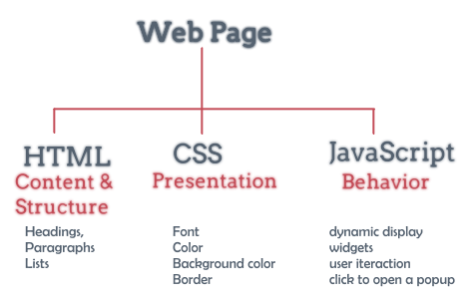
Basic Web Page Structure (1)

Slide 8
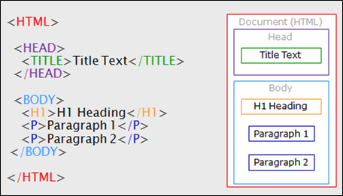
Basic Web Page Structure (2)

Slide 9
JavaScript: Hello world v.1
<!DOCTYPE html>
<html>
<head>
<title>Hello world v.1</title>
</head>
<body>
<input type="button" onclick="alert('Hello world!')" value="Click me"></input>
</body>
</html>

Slide 10
JavaScript: Hello world v.2
<!DOCTYPE html>
<html>
<head>
<title>Hello world v.2</title>
<script>
function HelloWorld() {
alert('Hello world 2!');
}
</script>
</head>
<body>
<input type="button" onclick="HelloWorld()" value="Click me"></input>
</body>
</html>

Slide 11
JavaScript: Hello world v.3
<!DOCTYPE html>
<html>
<head>
<title>Hello world v.3</title>
<script src="myScript.js"></script>
</head>
<body>
<input type="button" onclick="HelloWorld()" value="Click me"></input>
</body>
</html>

Slide 12
Resources
HTML learning dedicated books and websites like: https://www.w3schools.com/html/default.asp
CSS learning dedicated books and websites like: https://www.w3schools.com/css/default.asp
JavaScript learning dedicated books and websites like: https://www.w3schools.com/js/default.asp https://www.yourwebskills.com/contents.php https://www.w3schools.com/jquery/default.asp http://try.jquery.com https://www.w3schools.com/angular/default.asp https://www.tutorialspoint.com/angularjs/index.htm https://docs.angularjs.org/tutorial

